Slide 1
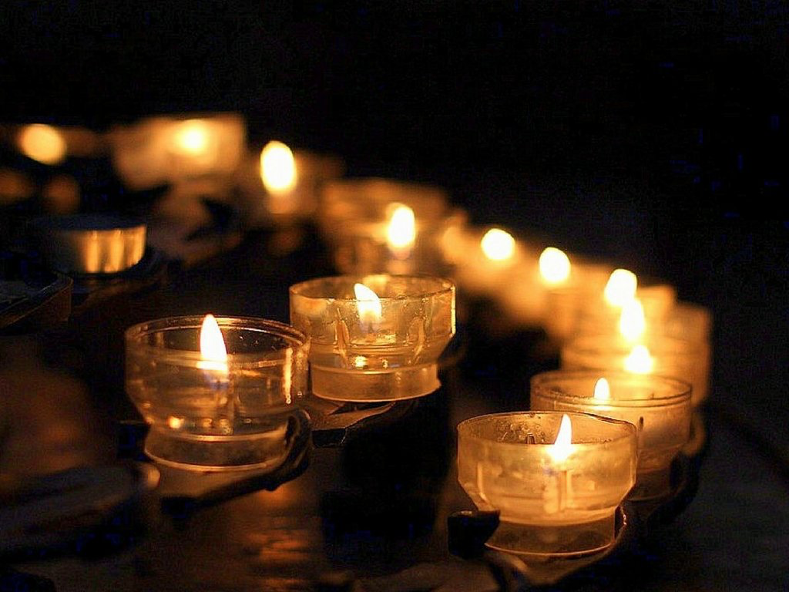
Welcome to
Worship
Springfield
Illinois

Slide 2
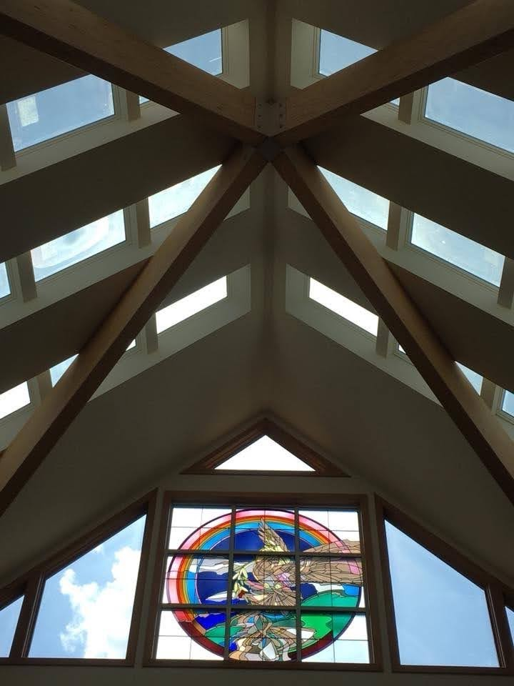
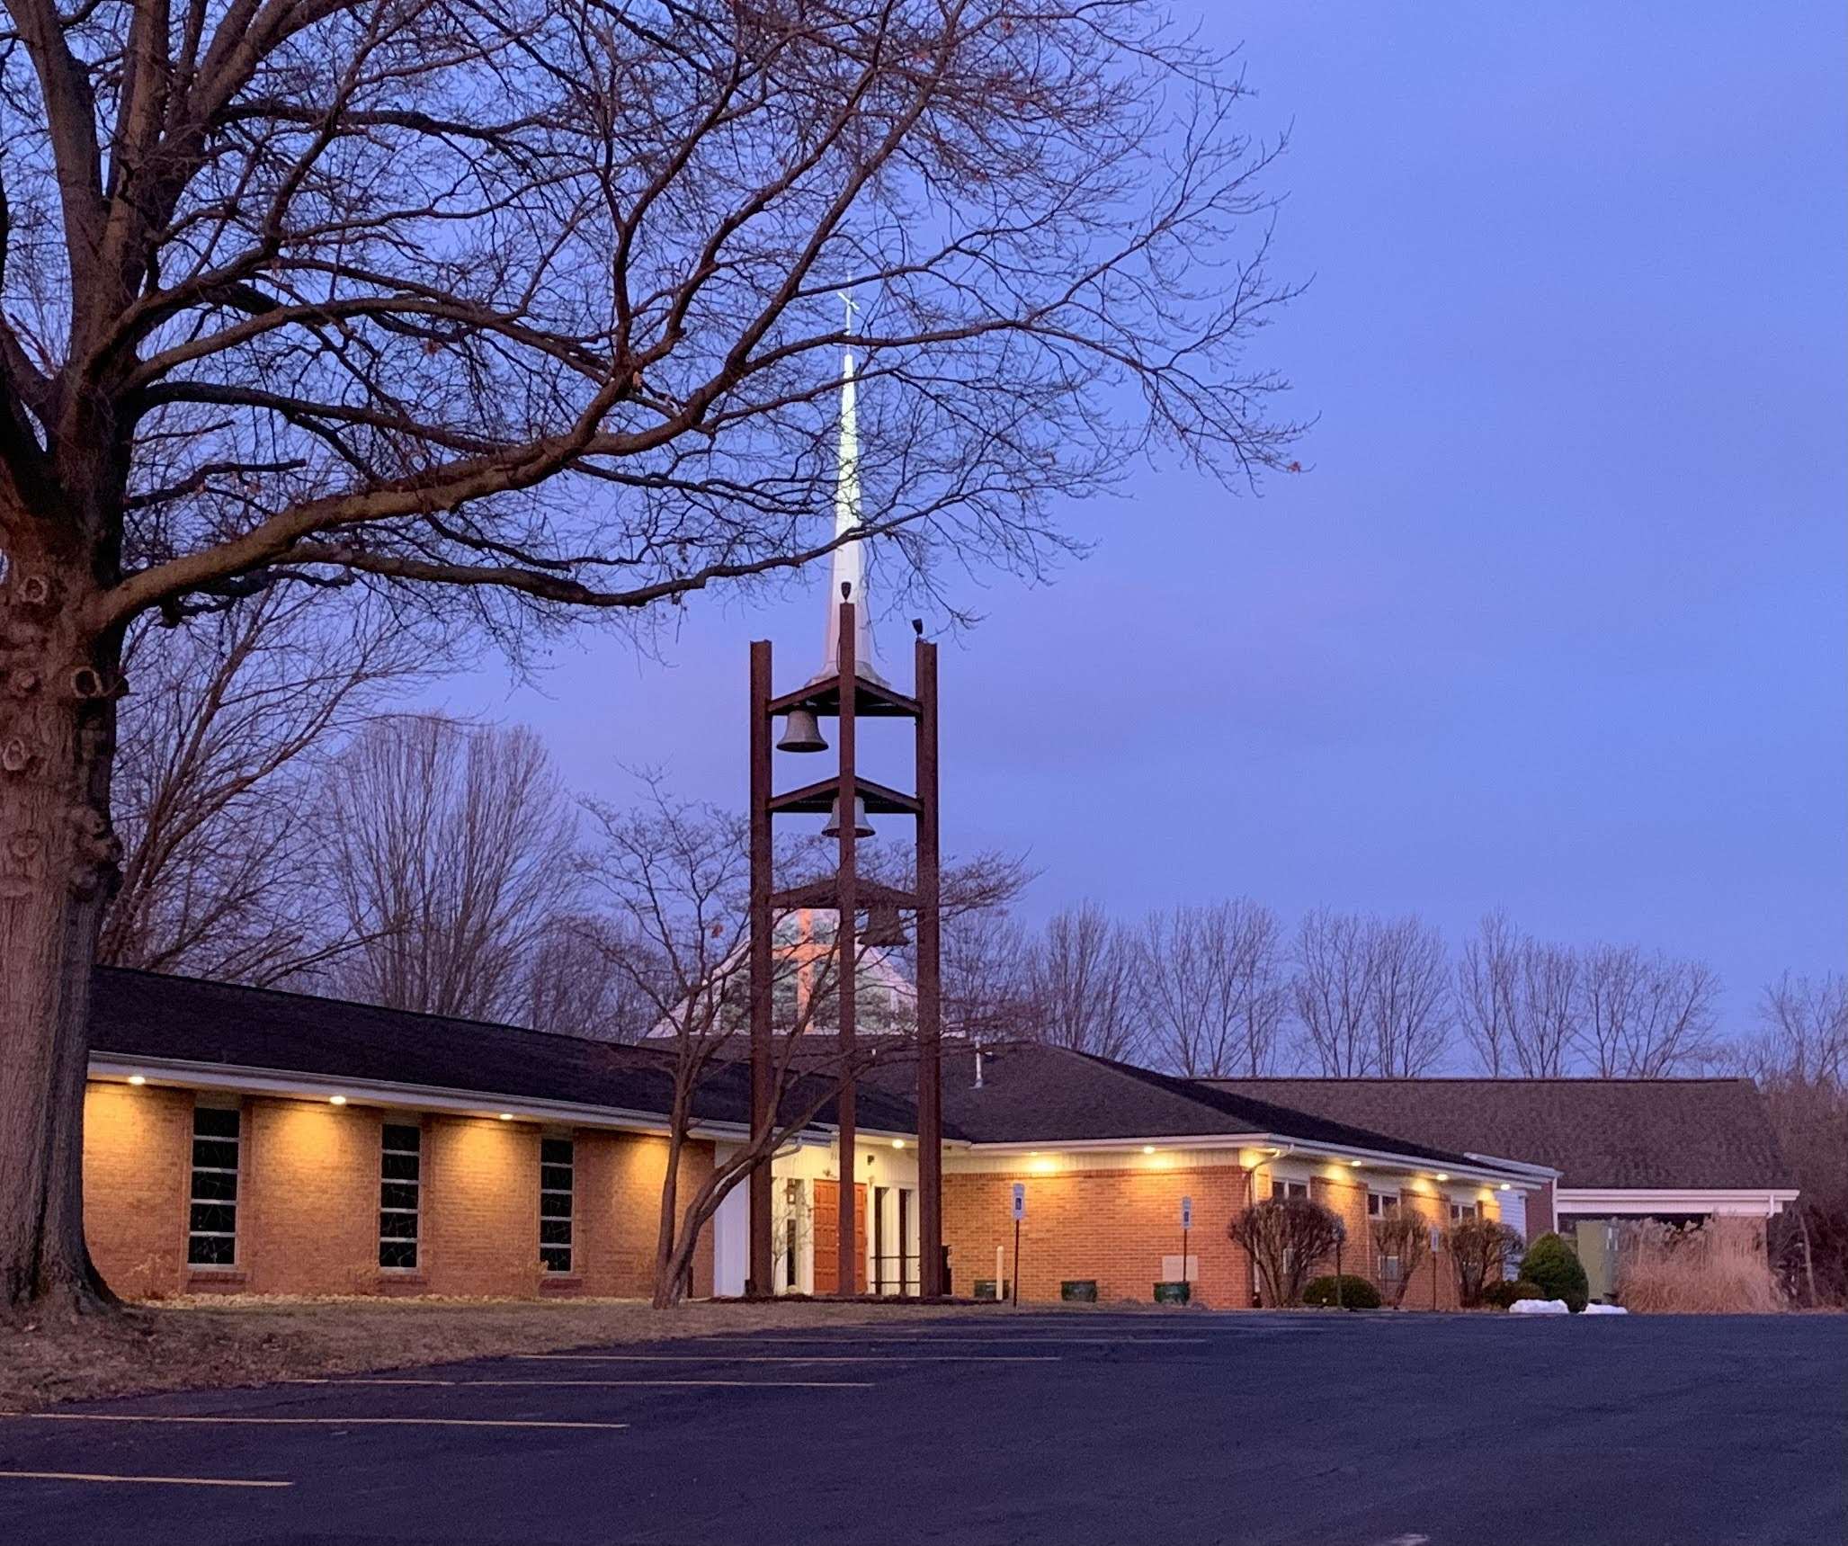
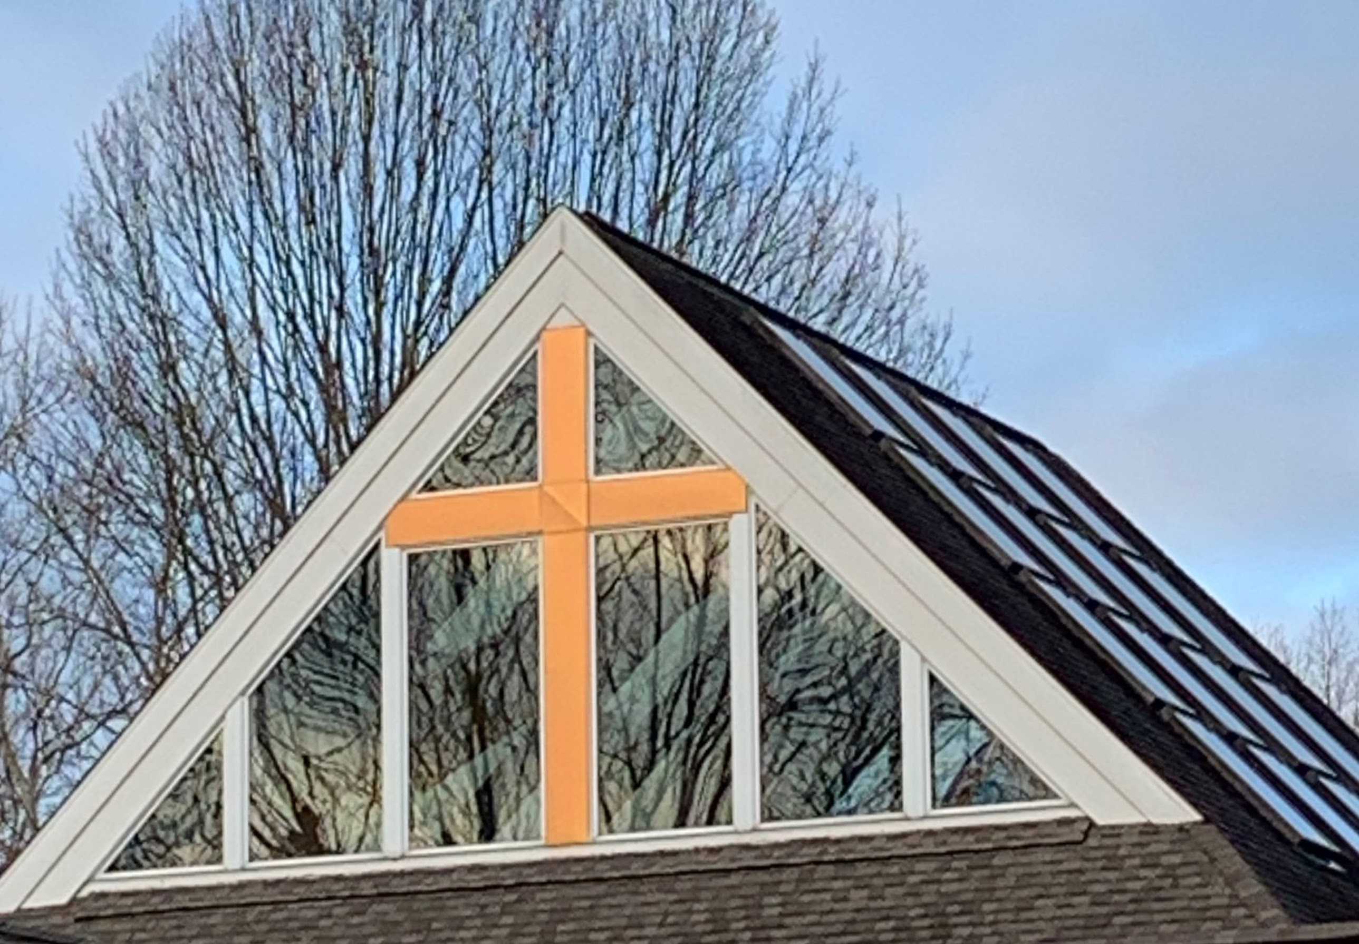
As disciples of Jesus Christ,
we share God’s grace and
mercy. We welcome and encourage all to grow with us
in God’s kingdom through praise, worship, and service.service.
Our Mission Statement

Slide 3
In this holy meal Jesus gives himself, promising forgiveness, life, and salvation. All baptized Christians are invited to receive Holy Communion.
Invitation to
Holy Commnion
Invitation to
Holy Communion

Slide 5
Happening this Week
Sunday, September 18
9:30 am In-Person Worship
& Livestream
10:30 am – Little Lambs
Faith Formation in Nursery

Slide 6
Sunday, September 18
6:00 pm – “Sundays @ 6” Faith Formation
On Zoom
Wednesday, September 21
7:00 pm – Choir Practice

Slide 7
OUTSIDE GROUPS USING THE BUILDING THIS WEEK
Monday, September 19
6:00 pm Stamp Club

Slide 8
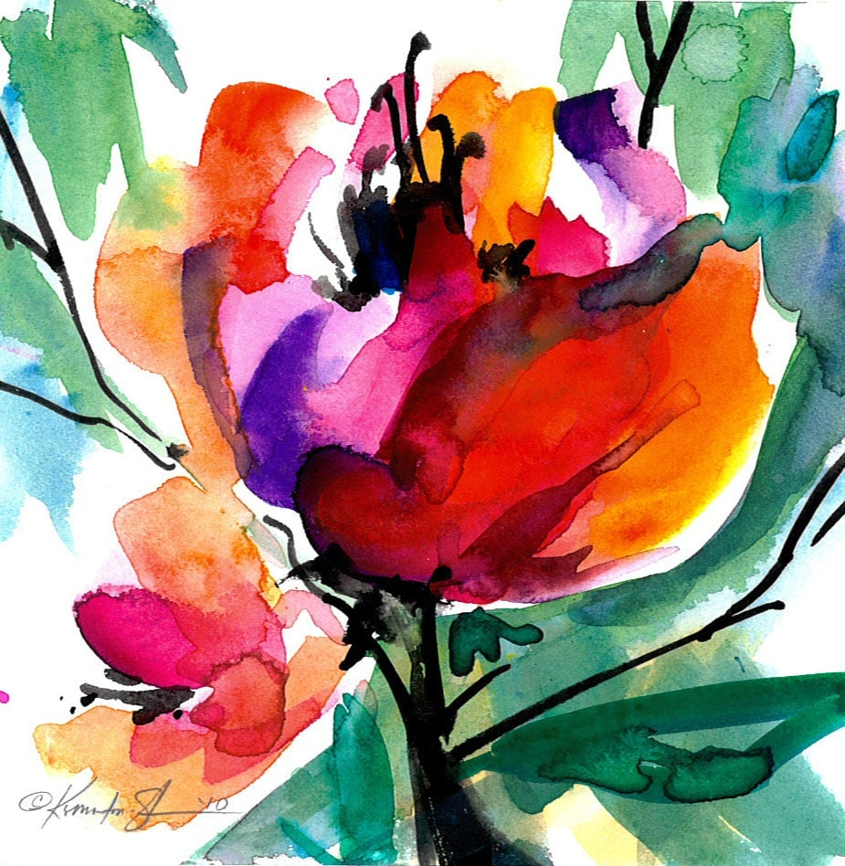
ALTAR FLOWERS
PLACED BY
Marilyn Henderson
To the Glory
of God

Slide 9
THANK YOU!!!
We filled 60 Meal Kits for local micro-pantries & 80 LWR School Kits

Slide 10
Coffee & Cookies
Fellowship Sponsored by:
Claire Edgecomb
This Photo by Unknown Author is licensed under CC BY-SA-NC

Slide 11
If you would like a visit from Pastor Mary OR have a pastoral emergency, PLEASE contact Pastor on her cell phone @ 920-671-4338. You may also call the church office @217-546-7646 and leave a message.

Slide 12
PEACE LUTHERAN
has an immediate opening for an
Office manager/
Financial secretary
Hours: 9a.m. – 2:30p.m.
Monday thru Friday
Competitive Wages
Contact Pastor Mary @ 920-671-4338

Slide 13
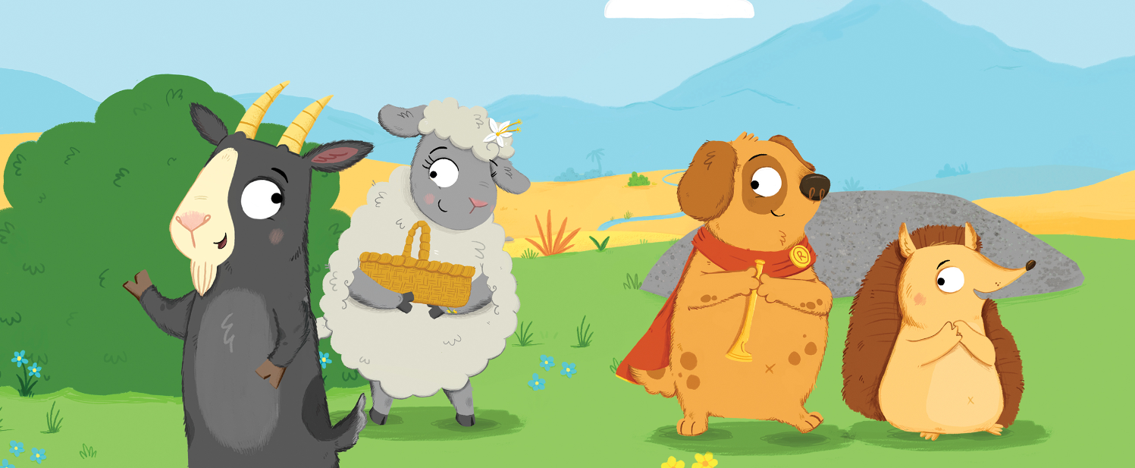
Faith Formation Birth to 5 yrs
Begins September 18
Watch NYCU for more information!

Slide 14
ELEMENTARY AGE
FAITH FORMATION 2022
September 11 – Family Service Project
September 18 – “Faith Formation to Go”
September 25 – Faith Formation Class
after Worship

Slide 15
Sundays@6
Adult Faith Formation
Beginning September 18
6 to 7 p.m. on Zoom
For details contact
Debi and Pete Ellersten
Edmund.ellertsen85@gmail.com
Or 217-793-2587

Slide 16
September 19
Elijah Hamilton
September 23
Jean Tweet

Slide 17
Sign up for
Altar Flowers
$35.00
Call the church office @
217.546.7646
Or sign up in the “Members” section of the Website

Slide 18
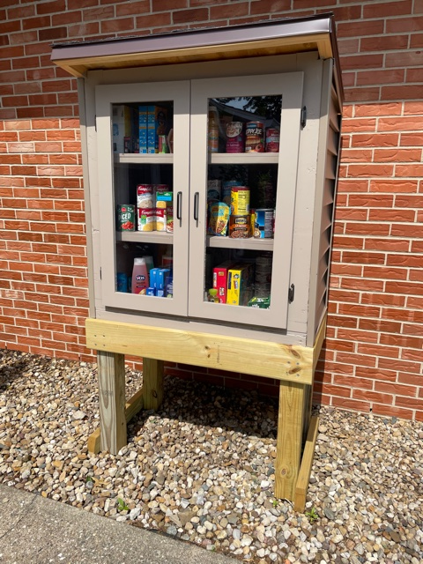
HELP KEEP OUR
MICROPANTRY
STOCKED
Non-perishables
may be put directly in the pantry or dropped off in the church office.

Slide 19
THOSE WHO HAVE ASKED FOR PRAYER:
Walter H
Judy B
Harriett B

Slide 20
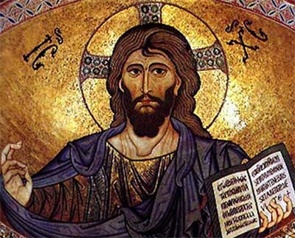
REIGN OF
CHRIST
SUNDAY
Peace Lutheran
Springfield, Illinois
This Photo by Unknown Author is licensed under CC BY-NC-ND

Slide 21
EXPLANATION OF THE DAY
Today we mark the end of the church year as we celebrate Christ the King Sunday. We acknowledge that the reign of God comes to us in unexpected ways: through life-giving love, a splash of water, and a bit of bread and wine. We acknowledge that the reign of God welcomes the weak, heals the broken, and restores wholeness.
On this day we proclaim the reign of God’s love for us in all seasons and times.
Today in worship we will journey through the whole ‘liturgical year,’ or the way the church marks time. Beginning with Advent and continuing through the season after Pentecost, we will recall the entire great wheel that is the seasons of the church year, beginning and ending with this day, in which we honor and celebrate Christ who is King, in all seasons and time, ready to turn once again, next Sunday to a new church year.

Slide 22
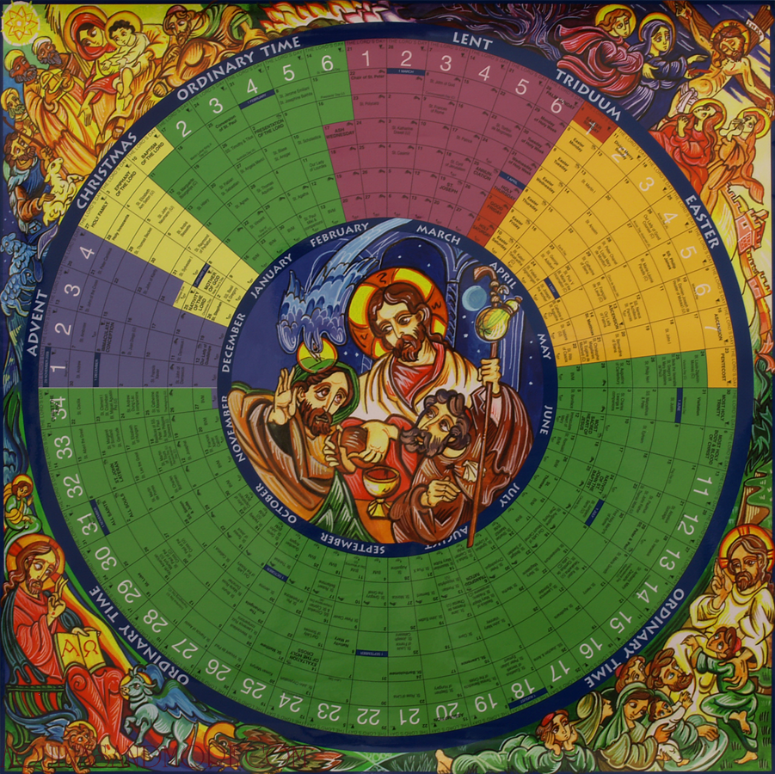

Slide 23
GATHERING HYMN
Come, Thou Almighty King
ELW #408
Come, thou almighty King,
help us thy name to sing;
help us to praise;

Slide 24
Father all-glorious,
o'er all victorious,
come and reign over us,
Ancient of Days.

Slide 25
Come, thou incarnate Word,
merciful, mighty Lord;
our prayer attend.
Come and thy people bless,
and give thy word success,
and let thy righteousness
on us descend.

Slide 26
Come, holy Comforter,
thy sacred witness bear
in this glad hour!
Thou who almighty art,
rule now in ev'ry heart,
never from us depart,
Spirit of pow'r.

Slide 27
To thee, great One in Three,
eternal praises be
hence evermore!
Thy sov'reign majesty
may we in glory see,
and to eternity
love and adore.
Text: source unknown, c. 1757, alt. Public Domain

Slide 28
PRAYER OF THE DAY
Let us pray. Almighty and ever-living God, you anointed your beloved Son to be priest and sovereign forever. Grant that all the people of the earth, now divided by the power of sin, may be united by the glorious and gentle rule of Jesus Christ, our Savior and Lord, who lives and reigns with you and the Holy Spirit, one God, now and forever. Amen.

Slide 29
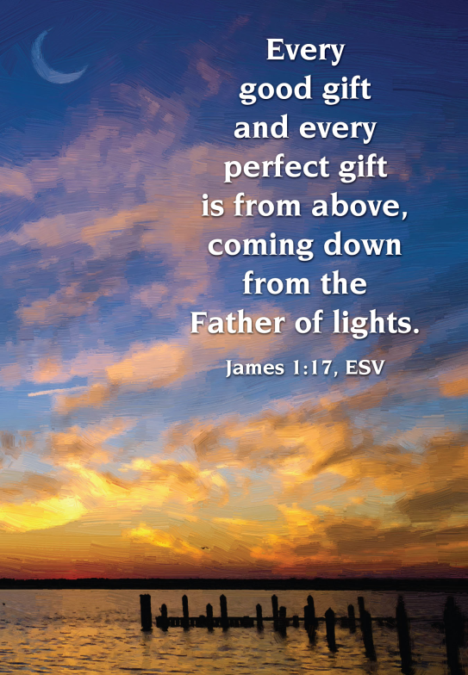
Advent – Blue: The Season of Expectation
The first season of the church year, Advent, is about beginnings, middles and endings. Advent means ‘coming’ or ‘arrival’, and so we prepare for the celebration of the birth of Jesus. However, we also look to the end times as we await Christ’s coming again and the fulfillment of God’s plan of justice and peace for all creation. These beginnings and endings give us pause to think about what it means to live, as we do, in the middle. And so we light candles against the darkness, keeping watch for the promised light.
Placing of Advent Blue
Notes:
Cross with blue ribbon.

Slide 30
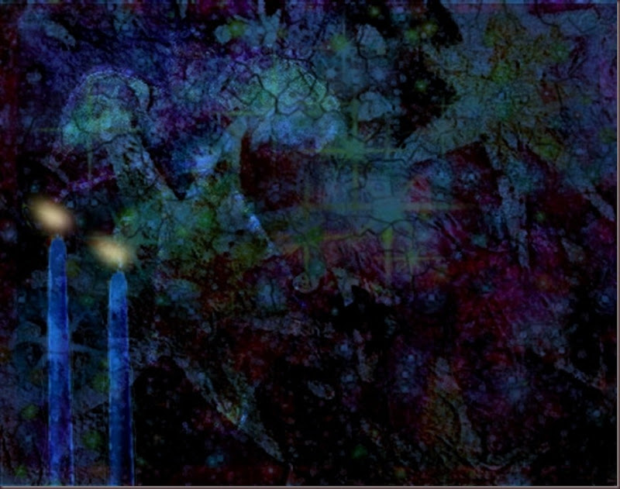
Advent
Season of Expectation

Slide 31
READING
Isaiah 11:1-3, 6
A shoot shall come out from the stock of Jesse, and a branch shall grow out of his roots. The spirit of the LORD shall rest on him, the spirit of wisdom and understanding, the spirit of counsel and might, the spirit of knowledge and the fear of the LORD.

Slide 32
His delight shall be in the fear of the LORD. The wolf shall live with the lamb, the leopard shall lie down with the kid, the calf and the lion and the fatling together, and a little child shall lead them.
The word of the Lord.
Thanks be to God.

Slide 33
ADVENT HYMN
O Come, O Come, Emmanuel
ELW #257 (vv 1-3)
O come, O come, Emmanuel,
and ransom captive Israel,
that mourns in lonely exile here
until the Son of God appear.

Slide 34
Rejoice! Rejoice! Emmanuel
shall come to you, O Israel.

Slide 35
O come, O Wisdom from on high,
embracing all things far and nigh:
in strength and beauty come and stay;
teach us your will and guide our way.

Slide 36
Rejoice! Rejoice! Emmanuel
shall come to you, O Israel.

Slide 37
O come, O come, O Lord of might,
as to your tribes on Sinai's height
in ancient times you gave the law
in cloud, and majesty, and awe.

Slide 38
Rejoice! Rejoice! Emmanuel
shall come to you, O Israel.
Text: Psalteriolum Cantionum Catholicarum, Köln, 1710; tr. composite
Text sts. 2, 6, 7 © 1997 Augsburg Fortress.

Slide 39
CHRISTMAS- The Season of Emmanuel
Christmas marks the arrival of Emmanuel, God with us. The season of Christmas begins with the celebration of the birth of Jesus and continues for twelve days, ending on January 6. After the quiet anticipation of Advent, we celebrate with carols, feasts and acts of charity. What does it mean that we have a God who chose to dwekk with us, sharing in the suffering, wonder, joy and sorrow of being human?
The color of Christmas is white, symbolizing the light and joy of the newborn King.
Placing of White

Slide 40
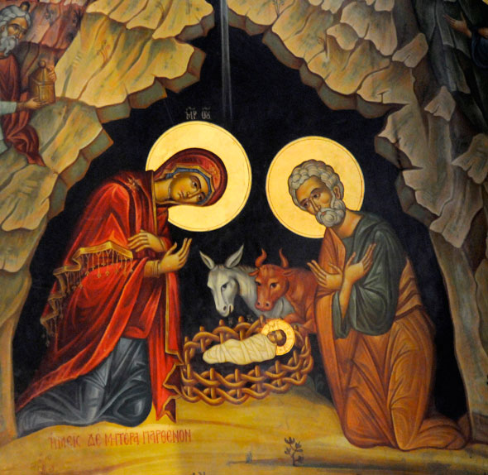
Christmas
Season of Immanuel
Notes:
Cross with White ribbon.

Slide 41
READING
John 1:1-5, 14
In the beginning was the Word, and the Word was with God, and the Word was God. He was in the beginning with God. All things came into being through him, and without him not one thing came into being. What has come into being in him was life,

Slide 42
and the life was the light of all people. The light shines in the darkness, and the darkness did not overcome it…And the Word became flesh and lived among us, and we have seen his glory, the glory as of a father’s only son, full of grace and truth.
The word of the Lord.
Thanks be to God.

Slide 43
CHRISTMAS HYMN
Infant Holy, Infant Lowly
ELW #276
Infant holy, infant lowly,
for his bed a cattle stall;
oxen lowing, little knowing
Christ the child is Lord of all.

Slide 44
Swiftly winging, angels singing,
bells are ringing, tidings bringing:
Christ the child is Lord of all!
Christ the child is Lord of all!

Slide 45
Flocks were sleeping,
shepherds keeping
vigil till the morning new
saw the glory, heard the story,
tidings of a gospel true.

Slide 46
Thus rejoicing, free from sorrow,
praises voicing, greet the morrow:
Christ the child was born for you!
Christ the child was born for you.
Text: Polish carol; tr. Edith M. G. Reed, 1885-1933, alt. Music: Polish carol
Hymn is in Public Domain.

Slide 47
EPIPHANY : White the Season of Light for the World and then green, for the Sundays following:
January 6th is the Day of Epiphany, the final day of Christmas. Epiphany ‘manifestation’. How is this God-with-us revealed? Through the light of a star to the Wise Men, through a descending dove at Jesus’ baptism, through every act of love and grace that comes to us. Where do we see Christ’s light now, manifest in our lives? Where are the dark corners of the world where we need to share it? During the Sundays following Epiphany we enter what is called ‘Ordinary Time’, clothes in the color of green to symbolize our growth as we learn of Jesus’ teachings and ministry

Slide 48
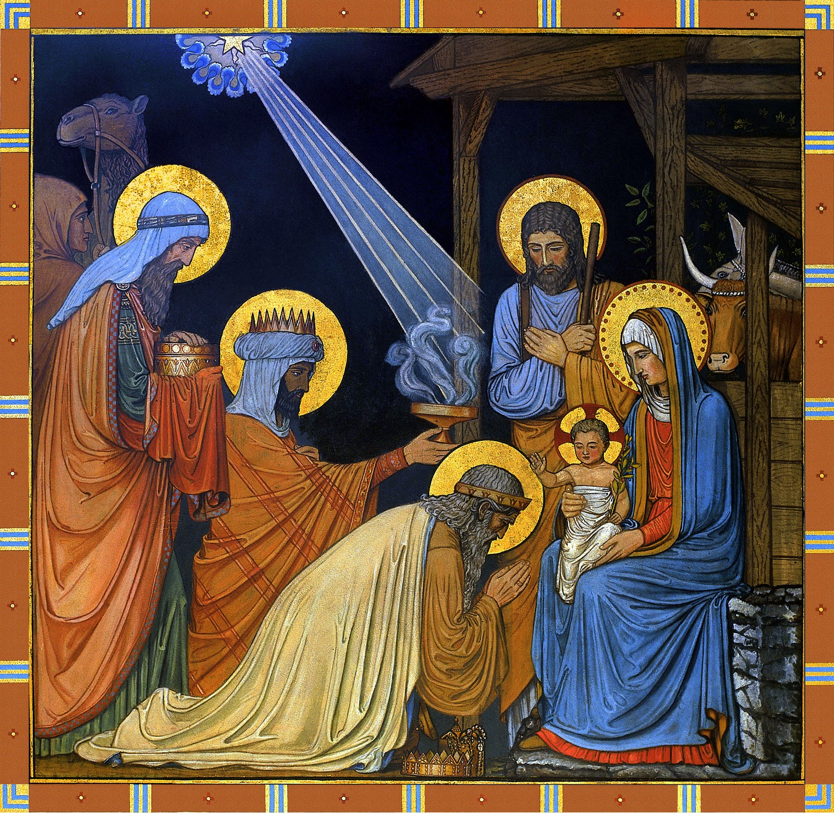
Epiphany and the Season After
Season of Light for the World

Slide 49
READING
Matthew 2:1-12
In the time of King Herod, after Jesus was born in Bethlehem of Judea, wise men from the East came to Jerusalem, asking, ‘Where is the child who has been born king of the Jews?

Slide 50
For we observed his star at its rising, and have come to pay him homage.’ When King Herod heard this, he was frightened, and all Jerusalem with him; and calling together all the chief priests and scribes of the people, he inquired of them where the Messiah was to be born. They told him, ‘In Bethlehem of Judea; for so it has been written by the prophet:

Slide 51
“And you, Bethlehem, in the land of Judah, are by no means least among the rulers of Judah; for from you shall come a ruler who is to shepherd my people Israel.” ’ Then Herod secretly called for the wise men and learned from them the exact time when the star had appeared.

Slide 52
Then he sent them to Bethlehem, saying, ‘Go and search diligently for the child; and when you have found him, bring me word so that I may also go and pay him homage.’ When they had heard the king, they set out; and there, ahead of them, went the star that they had seen at its rising,

Slide 53
until it stopped over the place where the child was. When they saw that the star had stopped, they were overwhelmed with joy. On entering the house, they saw the child with Mary his mother; and they knelt down and paid him homage.

Slide 54
Then, opening their treasure-chests, they offered him gifts of gold, frankincense, and myrrh. And having been warned in a dream not to return to Herod, they left for their own country by another road.

Slide 55
The word of the Lord.
Thanks be to God.

Slide 56
EPIPHANY HYMN
As with Gladness Men of Old
ELW #302 verses 1-3
As with gladness men of old
did the guiding star behold;

Slide 57
as with joy they hailed its light,
leading onward, beaming bright;
so, most gracious Lord, may we evermore be led by thee.

Slide 58
As with joyful steps they sped,
Savior, to thy lowly bed,
there to bend the knee before
thee, whom heav’n and earth adore;
so may we with willing feet
ever seek thy mercy seat.

Slide 59
As they offered gifts most rare
at thy cradle, rude and bare,
so may we with holy joy,
pure and free from sin’s alloy,
all our costliest treasures bring,
Christ, to thee, our heav’nly king.
Text: William C. Dix, 1837-1898, alt. Music: Conrad Kocher, 1786-1872
Hymn is in Public Domain.

Slide 60
LENT– The Season of Turning to God
Lent marks the 40 days plus six Sundays before Easter, recalling Jesus’ forty days in the wilderness preceding the beginning of his ministry. We too enter a wilderness time of confession, repentance, and renewal of faith. We make our worship place plain, we forego Alleluias, and we practice the traditional Lenten disciplines of prayer, fasting, and almsgiving, or service to others. The days lengthen in light even as we follow our Lord to Jerusalem, and to the cross.
Placing of the Lenten Purple

Slide 61
Season of Turning to God

Slide 62
READING
Psalm 51:10-12, 15-17
Create in me a clean heart, O God, and put a new and right spirit within me.
Do not cast me away from your presence, and do not take your holy spirit from me.
Notes:
Not sure if you want congregation to read responsively

Slide 63
Restore to me the joy of your salvation, and sustain in me a willing spirit.
O Lord, open my lips, and my mouth will declare your praise.
For you have no delight in sacrifice; if I were to give a burnt-offering, you would not be pleased.

Slide 64
The sacrifice acceptable to God is a broken spirit;
a broken and contrite heart, O God, you will not despise.

Slide 65
LENTEN HYMN
O Lord, Throughout These Forty Days
ELW #319 (vv 1-2 & 4)
O Lord, throughout these forty days
you prayed and kept the fast;
inspire repentance for our sin,
and free us from our past.

Slide 66
You strove with Satan, and you won;
your faithfulness endured;
lend us your nerve, your skill, and trust
in God's eternal word.

Slide 67
Be with us through this season, Lord,
and all our earthly days,
that when the final Easter dawns,
we join in heaven's praise.
Text: based on Claudia F. Hernaman, 1838-1898; para. Gilbert E. Doan Jr., b. 1930
Text © 1978 Lutheran Book of Worship, admin. Augsburg Fortress.

Slide 68
CONFESSION AND PRAYERS
Let us pray.
Holy God, holy and mighty, holy and immortal,
have mercy on us.

Slide 69
For self-centered living, and for failing to walk with humility and gentleness:
Holy God, holy and mighty, holy and immortal, have mercy on us.

Slide 70
For reluctance in sharing the gifts of God, and for carelessness with the fruits of creation:
Holy God, holy and mighty, holy and immortal, have mercy on us.

Slide 71
For misuse of human relationships, and for unwillingness to see the image of God in others:
Holy God, holy and mighty, holy and immortal, have mercy on us.

Slide 72
For jealousies that divide families and nations, and for rivalries that create strife and warfare, we pray. Bring us your peace, and strengthen first responders and all who serve and protect us. Lord, in your mercy,
Hear our prayer.

Slide 73
For our failure to notice the needs of others, and to respond to them with love and grace. We pray for the friends of our congregation who are unable to join our worship in person and for all who are sick and suffering. We pray for those on our prayer list. Lord, in your mercy,
Hear our prayer.

Slide 74
We offer our confession, our hearts, and our prayers in the name of our Lord and Savior, Jesus Christ.
Amen.

Slide 75
By grace you have been saved.
May almighty God strengthen you with power through the Holy Spirit, that Christ may live in your hearts through faith.
Amen.

Slide 76
PEACE
The peace of Christ be with you always.
And also with you.

Slide 77
THANK YOU FOR YOUR CONTINUED SUPPORT OF PEACE LUTHERAN CHURCH
OFFERING OF TITHES & GIFTS
The offering is collected at this time.
www.peacelutheranspringfield.org
CHOIR ANTHEM: Shepherd of My Life
Joseph M. Martin

Slide 78
OFFERING HYMN
We Are An Offering
ELW #692
We lift our voices, we lift our hands,
we lift our lives up to you:
we are an offering.

Slide 79
Lord use our voices,
Lord, use our hands,
Lord use our lives, they are yours:
we are an offering.
All that we have, all that we are,
all that we hope to be,
we give to you, we give to you.ext:

Slide 80
We lift our voice,
we lift our hands,
we lift our lives up to you:
we are an offering,
we are an offering.
Frank von Christierson, 1900-1996, alt. Music: English folk tune; arr. Ralph Vaughan Williams, 1872-1958 Text © 1961, ren. 1989 The Hymn Society, admin. Hope Publishing Company Arr © Oxford University Press

Slide 81
OFFERING PRAYER
Let us pray. Merciful God, as grains of wheat scattered upon the hills were gathered together to become one bread, so let your church be gathered together from the ends of the earth into your kingdom, for yours is the glory through Jesus Christ, now and forever. Amen.

Slide 82
Easter – White and Gold: The Season of Life
Alleluia, He is risen!
(He is risen indeed, alleluia!)
On Easter Sunday we remember with joy the resurrection of Jesus, celebrating together for an amazing fifty days. During this time, we hear accounts of resurrection appearances and stories of the new community that formed from this Good News, news that turned despair and fear into hope and love. What does it mean for our lives that death is not the end? How do we live as Easter people, claiming the hope of the Resurrection?

Slide 83
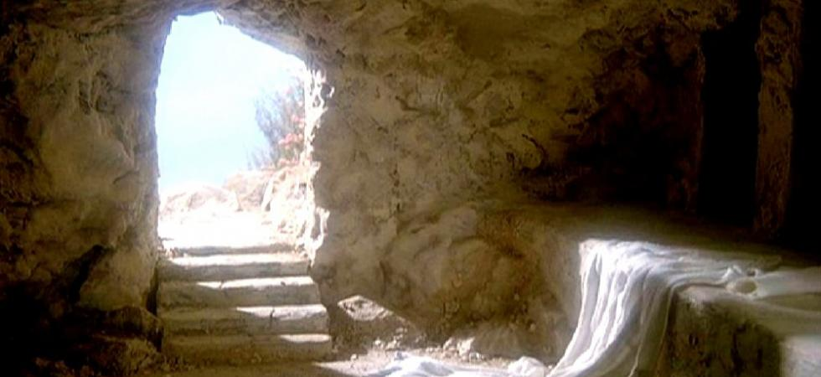
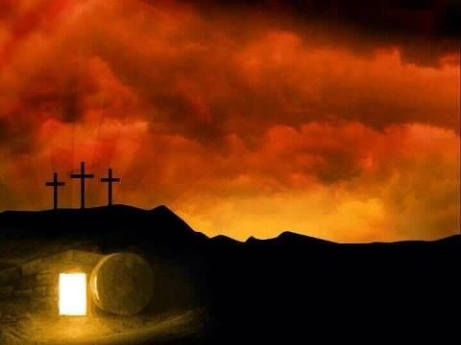
Easter
Season of Life

Slide 84
READING
Luke 24:1-12
But on the first day of the week, at early dawn, they came to the tomb, taking the spices that they had prepared. They found the stone rolled away from the tomb, but when they went in, they did not find the body. While they were perplexed about this, suddenly two men in dazzling clothes stood beside them.

Slide 85
The women were terrified and bowed their faces to the ground, but the men said to them, ‘Why do you look for the living among the dead? He is not here, but has risen. Remember how he told you, while he was still in Galilee, that the Son of Man must be handed over to sinners, and be crucified, and on the third day rise again.’ Then they remembered his words, and returning from the tomb,

Slide 86
they told all this to the eleven and to all the rest. Now it was Mary Magdalene, Joanna, Mary the mother of James, and the other women with them who told this to the apostles. But these words seemed to them an idle tale, and they did not believe them. But Peter got up and ran to the tomb; stooping and looking in, he saw the linen cloths by themselves; then he went home, amazed at what had happened.

Slide 87
The word of the Lord.
Thanks be to God.

Slide 88
EASTER HYMN
Alleluia! Jesus Is Risen!
ELW #377 verses 1 & 4
Alleluia! Jesus is risen!
Trumpets resounding in glorious light! Splendor, the Lamb, heaven forever!
Oh, what a miracle God has in sight!

Slide 89
Jesus is risen and we shall arise.
Give God the glory! Alleluia!

Slide 90
Weeping, be gone; sorrow, be silent: death put asunder, and Easter is bright. Cherubim sing: O grave, be open!
Clothe us in wonder, adorn us in light.

Slide 91
Jesus is risen and we shall arise.
Give God the glory! Alleluia!
Text: Herbert F. Brokering, b. 1926 Music: David N. Johnson, 1922-1987
Text © 1995 Augsburg Fortress Music © 1969 Contemporary Worship 1, admin. Augsburg Fortress

Slide 92
GREAT THANKSGIVING
The Lord be with you.
And also with you.
Lift up your hearts.
We lift them to the Lord.
Let us give thanks to the Lord our God.
It is right to give our thanks and praise.

Slide 93
Eucharistic prayer
Holy, living, and loving God, we praise you for creating the heavens and the earth.
We bless you for bringing Noah and his family through the waters of the flood, for freeing your people Israel from the bonds of slavery, and for sending your Son to be our Redeemer.

Slide 94
We give you thanks for Jesus who, living among us, healed the sick, fed the hungry, and with a love stronger than death, gave his life for others.

Slide 95
In the night in which he was betrayed, our Lord Jesus took bread, and gave thanks; broke it, and gave it to his disciples, saying: Take and eat; this is my body, given for you.
Do this for the remembrance of me.

Slide 96
Again, after supper, he took the cup, gave thanks, and gave it for all to drink, saying:
This cup is the new covenant in my blood,
shed for you and for all people
for the forgiveness of sin.
Do this for the remembrance of me.

Slide 97
Remembering, therefore,
his life-giving death and glorious resurrection, we await your promised life for all
this dying world.

Slide 98
Breathe your Spirit on us and on this bread and cup: carry us in your arms from death to life, that we may live as your chosen ones, clothed in the righteousness of Christ.
Through him all glory and honor is yours, Almighty Father, with the Holy Spirit, in your holy Church, both now and forever.
Amen.

Slide 99
THE LORD’S PRAYER
Our Father, who art in heaven,
hallowed by thy name,
thy kingdom come,
thy will be done,
on earth as it is in heaven.

Slide 100
Give us this day our daily bread;
and forgive us our trespasses,
as we forgive those
who trespass against us;
and lead us not into temptation,
but deliver us from evil.

Slide 101
For thine is the kingdom,
and the power, and the glory,
forever and ever. Amen.

Slide 102
INVITATION TO COMMUNION
Share in the inheritance of all the saints.
Come to the table prepared for you.
Thanks be to God.

Slide 103
LAMB OF GOD
ELW P.208
O Lamb of God, you bear the sin of
all the world away;
you set us free from guilt and grave: have mercy now, we pray.

Slide 104
O Lamb of God, you bear the sin of all
the world away;
you set us free from guilt and grave:
have mercy now, we pray.

Slide 105
O Lamb of God, you bear the sin of
all the world away;
eternal peace with God you made:
give us your peace, we pray.

Slide 107
BEAUTIFUL SAVIOR
ELW #838
Beautiful Savior, King of creation,
Son of God and Son of Man!
Truly I'd love thee,
truly I'd serve thee,
light of my soul, my joy, my crown.

Slide 108
Fair are the meadows,
fair are the woodlands,
robed in flow'rs of blooming spring;
Jesus is fairer,
Jesus is purer,
he makes our sorrowing spirit sing.

Slide 109
Fair is the sunshine,
fair is the moonlight,
bright the sparkling stars on high;
Jesus shines brighter,
Jesus shines purer
than all the angels in the sky.

Slide 110
Beautiful Savior,
Lord of the nations,
Son of God and Son of Man!
Glory and honor,
praise, adoration,
now and forevermore be thine!
Text: Gesangbuch, Münster, 1677; tr. Joseph A. Seiss, 1823-1904

Slide 111
TABLE BLESSING
The body and blood of our Lord Jesus Christ
strengthen you and keep you in his grace.
Amen.

Slide 112
Pentecost & Ordinary Time: The Season of Growing
The Day of Pentecost is the fiftieth day of Easter, a day to celebrate the gift of the Holy Spirit and the birth of the church, community in Christ. The color red reminds us of the Spirit’s appearance as tongues of flame, dancing on the heads of the followers. Pentecost is the grand culmination of our joyous fifty days of Easter. After Pentecost we are again in ordinary time, with a focus on Jesus’ life and teachings. The GREEN reminds us that we are to continue to grow as disciples of Jesus Christ.
Placing of RED. And GREEN after Pentecost

Slide 113
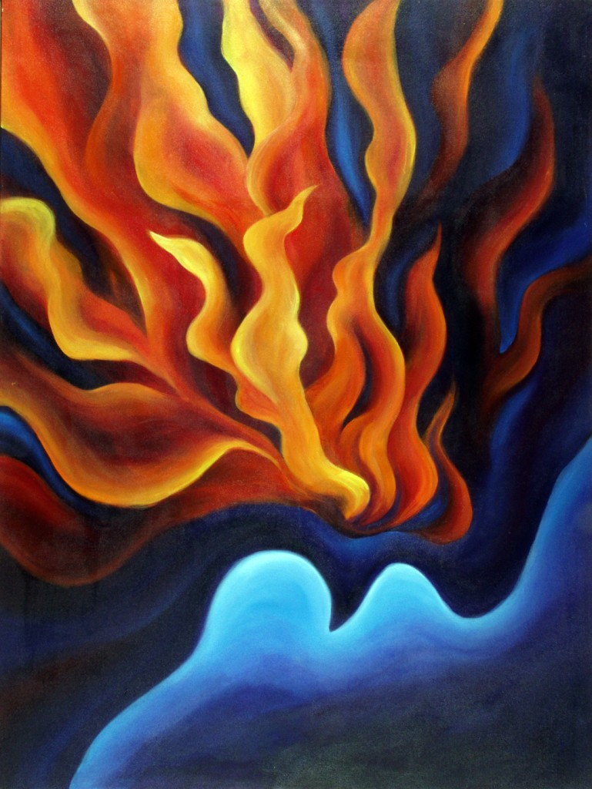
Pentecost and
the Season after

Slide 114
READING
Acts 2:17-21
“In the last days it will be, God declares, that I will pour out my Spirit upon all flesh, and your sons and your daughters shall prophesy, and your young men shall see visions, and your old men shall dream dreams.

Slide 115
Even upon my slaves, both men and women, in those days I will pour out my Spirit; and they shall prophesy. Then everyone who calls on the name of the Lord will be saved.”

Slide 116
The word of the Lord
Thanks be to God.

Slide 117
PENTECOST HYMN
God of Tempest, God of Whirlwind
ELW #400 verses 1-2
God of tempest, God of whirlwind,
as on Pentecost descend!
Drive us out from sheltered comfort; past these walls your people send!

Slide 118
Sweep us into costly service,
there with Christ to bear the cross,
there with Christ to bear the cross.
God of blazing, God of burning,
all that blocks your purpose, purge! Through your church,
Christ’s living Body,

Slide 119
let your flaming Spirit surge!
Where deceit conceals injustice,
kindle us to speak your truth,
kindle us to speak your truth.
Text: Herman G. Stuempfle Jr., b. 1923 Music: John Hughes, 1873-1932
Text © 2000 GIA Publications, Inc. Reprinted under OneLicense.net A-725771

Slide 120
CHRIST THE KING– In All Seasons and Time
Our church year ends with our celebration of Christ our King for all seasons and time. The one who came as a babe in a manger nearly 2000 years ago has not left us but reigns as our living King. What does it mean to allow Christ to rule our days, our decisions, our lives? It means expectation, God-with-us, and light for the world; it means turning toward God, the triumph of life, and the fire of the Holy Spirit in our hearts as we follow the way of Jesus’ teachings and life. Now, we go from this place knowing that next week we return in joyful expectation, to begin a new year. The wheel, ever old, turns once again into our lives, ever new. Thanks be to God, in all seasons and time. Placing of White/Gold

Slide 121
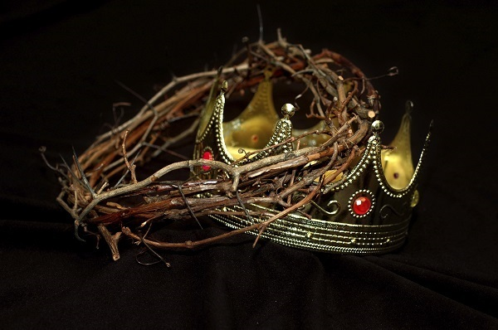
Christ the King
In All Seasons and All Times

Slide 122
READING
Colossians 1:15-20
He is the image of the invisible God, the firstborn of all creation; for in him all things in heaven and on earth were created, things visible and invisible, whether thrones or dominions or rulers or powers—

Slide 123
all things have been created through him and for him. He himself is before all things, and in him all things hold together. He is the head of the body, the church; he is the beginning, the firstborn from the dead, so that he might come to have first place in everything. For in him all the fullness of God was pleased to dwell, and through him God was pleased to reconcile to himself all things,

Slide 124
whether on earth or in heaven, by making peace through the blood of his cross.
The word of the Lord.
Thanks be to God.

Slide 125
REIGN OF CHRIST HYMN
Jesus Shall Reign
ELW #434 (vv 1, 4, 5)
Jesus shall reign where’er the sun
does its successive journeys run;
his kingdom stretch from shore to shore, till moons shall wax and wane no more.

Slide 126
Blessings abound where’er he reigns:
the pris-’ners leap to lose their chains,
the weary find eternal rest,
and all who suffer want are blest.

Slide 127
Let ev’ry creature rise and bring
peculiar honors to our king;
angels descend with songs again;
and earth repeat the loud amen.
Text: Isaac Watts, 1674-1748, alt. Music: attr. John Hatton, d. 1793
Hymn is in Public Domain.

Slide 128
BLESSING
God who loves us, who gives us eternal consolation and good hope, comfort your hearts and strengthen them in every good work and word; and the blessing of almighty God, Father, + Son, and Holy Spirit, be among you and remain with you forever.
Amen.

Slide 129
SENDING HYMN
Lift High the Cross
ELW #660
Lift high the cross,
the love of Christ proclaim
till all the world adore
his sacred name.

Slide 130
Come, Christians,
follow where our captain trod,
our king victorious, Christ,
the Son of God.

Slide 131
Lift high the cross,
the love of Christ proclaim
till all the world adore
his sacred name.

Slide 132
All newborn servants of the Crucified
bear on their brows
the seal of him who died.

Slide 133
Lift high the cross,
the love of Christ proclaim
till all the world adore
his sacred name.

Slide 134
O Lord, once lifted on the glorious tree,
as thou hast promised,
draw us all to thee.

Slide 135
Lift high the cross,
the love of Christ proclaim
till all the world adore
his sacred name.

Slide 136
So shall our song of triumph ever be:
praise to the Crucified for victory!

Slide 137
Lift high the cross,
the love of Christ proclaim
till all the world adore
his sacred name.
Text: George W. Kitchin, 1827-1912; rev. Michael R. Newbolt, 1874-1956
Text © 1974 Hope Publishing Company, Carol Stream, IL 60188. All rights reserved. Used by permission.

Slide 138
DISMISSAL
Go in peace.
Christ is our King.
Thanks be to God.
Liturgy reprinted from Lutheran Book of Worship © 1978 and Evangelical Lutheran Worship © 2006. Augsburg Fortress. All rights reserved. Liturgy also reprinted from Sundays and Seasons, © 2016 Augsburg Fortress. All rights reserved. Used by permission of Augsburg Fortress license #SB121760.
This Photo by Unknown Author is licensed under CC BY-NC-ND

